Slide 1
Computer Architecture Concepts
Part 5 – Computer Components: Adder and Multiplexer

Slide 2
Objectives
Using understanding of basic logic gates and binary numbers, start to build components that can carry out useful functions in a computer

Slide 3
Recap – Logic Gates
To benefit from this topic, you will should be familiar with the following gates and their truth tables
AND gate XOR gate

Slide 4
Adding binary numbers
To start to build a circuit capable of adding binary numbers, first we consider adding two single bits together
There are four possible combinations of two binary inputs and we need two digits to store the totals
Inputs |  | Total
A | B | 2 | 1
0 | 0
0 | 1
1 | 0
1 | 1
0
0
0
1
0
1
1
0

Slide 5
Half Adder
A half adder is an arithmetic circuit that adds two bits
The circuit has two inputs (A, B) and two outputs (Sum, Carry)
We call it carry because it’s the value that will be carried to the next position on the left
From looking at the truth table, what gates can be used for sum and carry?
 |  | Total
A | B | Carry | Sum
0 | 0
0 | 1
1 | 0
1 | 1
0
0
0
1
0
1
1
0

Slide 6
Full Adder
To add two numbers together, we need to be able to add three bits, because there might be a carried bit
A full adder is a circuit that can add three bits
Two half adders can be joined together to create a full adder
The circuit has three inputs ( A, B, Carry_in ) and two outputs ( Sum, Carry_out )
Two outputs are needed because the sum of three binary digits ranges from 0 to 3 and the binary equivalent of 2 or 3 requires two digits
A | B | Carry in | Carry out | Sum
0 | 0 | 0
0 | 0 | 1
0 | 1 | 0
0 | 1 | 1
1 | 0 | 0
1 | 0 | 1
1 | 1 | 0
1 | 1 | 1
0
0
0
1
0
1
1
0
0
1
1
0
1
0
1
1

Slide 7
Multiplexer
A multiplexer is a component that selects one from multiple inputs depending on the value of a select (or control) input
This can be seen as a switch to determine which of several input signals to route to the single output

Slide 8
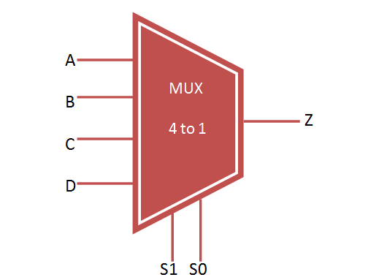
Multiplexer
The inputs S1 and S0 form a 2-bit number which is the select (control) signal
Representing the four decimal numbers 0 to 3 inclusive
The inputs A, B, C and D are the data that we want to select from to pass on
The output Z takes the value of one of A, B, C and D according to the select signal and the others are ignored
S1 | S0 | Z
0 | 0 | A
0 | 1 | B
1 | 0 | C
1 | 1 | D

Slide 9
Creating a 2 to 1 multiplexer
D0 | D1 | S | X
0 | 0 | 0 | 0
0 | 0 | 1 | 0
0 | 1 | 0 | 0
0 | 1 | 1 | 1
1 | 0 | 0 | 1
1 | 0 | 1 | 0
1 | 1 | 0 | 1
1 | 1 | 1 | 1
A 2 to 1 multiplexer needs a 1 bit select signal (S)
We call the two 1-bit data signals D0 and D1
Select D0 when S is 0
Select D1 when S is 1
The 2 to 1 multiplexer will output 1 when
D0 is 1 AND S is 0
OR
D1 is 1 AND S is 1
The full truth table is on the right with a reduced version below
S | Out
0
1
D0
D1

Slide 10
Summary
We have described components that will be useful in creating a CPU
To add two binary numbers
To select one from a set of signals

